Slide 1
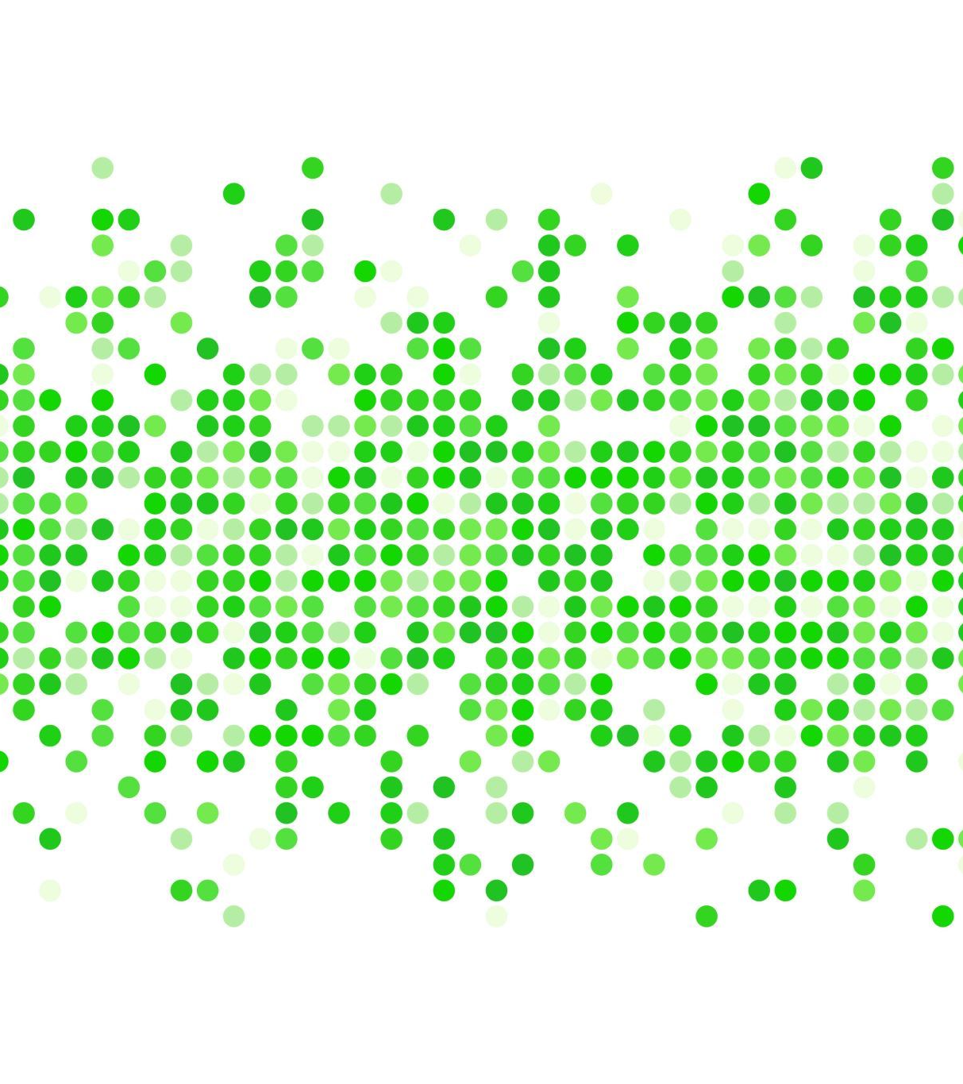
Q Learning vs Deep Q Learning
- by
Mario Anson (NUID : 002931419)
Aditya Shanmugham (NUID : 002738073)

Slide 2
Reinforcement Learning
- A method of rewarding positive behavior and punishing negative behavior
- An agent is set to explore an environment and train itself based on the experience it gained over the previous explorations
- Common reinforcement learning algorithms : SARSA, Q-Learning, Deep Q Learning

Slide 3
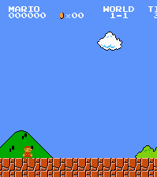
It's Mario Time
We have used Super Mario bros as a metric to evaluate the performance of Q learning algorithms against the Deep Q learning algorithm
Super Mario bro's is simulated using NES-py library using python
The state, action, reward are obtained using Open-AI's gym wrapper library

Slide 4

Q Learning
Runs on the principle of Bellman Equation
Involves a Q Table (state-action pair)
Has no optimal policy, actions are decided based on the "exploration-exploitation" factor
Performance is heavily dependent upon the Q Table size and lookup time.

Slide 5

Q Learning on Super Mario (Problems Faced)
- The states from the gym wrapper are snapshot of the game in real-time, each image is 240x256x3 in size
- The actions can be classified into - right, left, up, down, jump-right, jump-left, …
- Estimated size of the Q Table is (47,185,920 x 10)
- Its impractical to train an agent based on the size of the Q table.

Slide 6

Enhancements over Vanilla Q- Learning
Preprocessing the images:
Reduced the size of the image to 32x32 and converted the image to grayscale.
Reduced the color depth (bit-rate) from 8bit to 3bit.
Skipped 4 frames to avoid duplicate state processing

Slide 7

Enhancements over Vanilla Q-Learning (contd.)
Training Enhancements:
Used "Epsilon-Decay" to boost the exploitation term in the long run
Used "Experience-Factor" to boost exploitation in the known states
Used "Distance-metric" to reward the agent when it reaches further distance

Slide 8
Epsilon-Decay
Epsilon = min_epsilon + (max_epsilon – min_epsilon) + (-decay*epsilon)
- "Epsilon" is used to decide whether to exploit the experience gained (values from Q-table) or to explore new state by choosing random actions
- By using a decay factor, we can force the agent to exploit the experience over long training sessions.

Slide 9

Experience Factor
Save the number of times the agent has visited a particular state
Scale down the "visited score" by a factor (0.001)
Subtract the experience factor from the "epsilon" value to boost the exploitation probability

Slide 10

Distance Metric
Calculate the distance travelled by the agent from the beginning state
Add scaled down value to the reward
This metric encourages the agent to move forward instead of jumping in the same state (when the agent encounters a piranha)

Slide 11
Its Training Time !!!
We trained the Q Agent for over 2000 episodes
Total size of the Q-Table after the enhancements ~= 1,000,000
Size of the Q-Table (json) ~= 3 GB
Total reward earned at the end = 1510.0
Time spent per episode ~= 30s
Total time spent on training ~= 12 hours on CPU (i7-7700HQ)
Distance travelled ~= half of the total distance

Slide 12
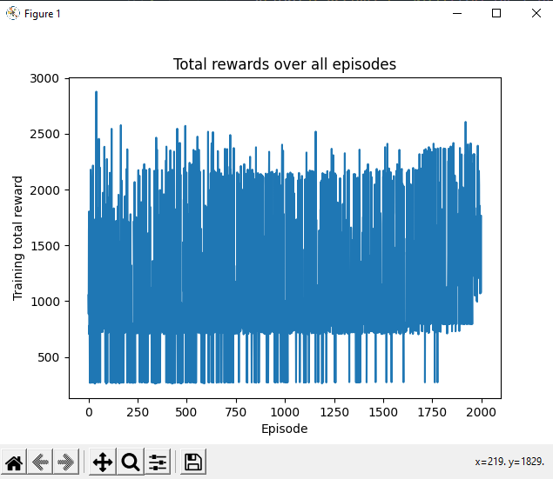
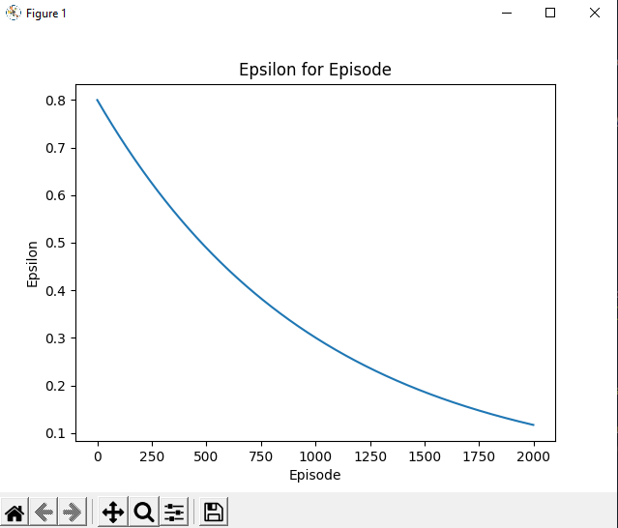
Graph it off

Slide 13

Why Deep Q – Learning?
Memory required to store and update the Q-Table increases as the number of states and actions increases
Time taken to train the Q-Table increases exponentially
A neural network can be used as a estimator function to approximate Q-table
Input = States; Output = Q values for all possible actions

Slide 14

Double Deep Q - Learning
To avoid overestimation and initial bias when exploring new states and action, two networks are used
"Online" and "Target" CNN has same skeleton
"Online" network is used to train the experiences (states)
"Target" network is used to prevent the overestimation of values, we copy the weights from "Online" network after every 'c' steps

Slide 15
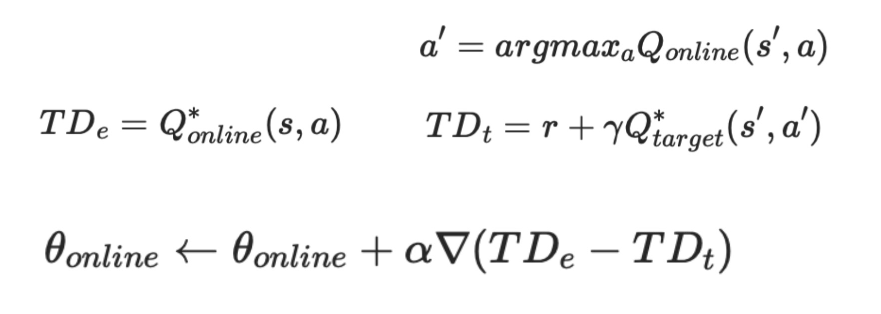
Double Deep Q Learning (contd.)
Used "exploration-exploitation" factor to determine the best action
Exploration factor = min(0.1, exploration factor * decay)

Slide 16

Training Enhancements
Limited the actions to "right" and "Jump-right"
Converted the images (state) to "Grayscale
"Resized" the images to 84x84 to improve the performance
Used "Skip frames" to skip redundant frames in the game
Used "Stack Frames" to capture the relation between current state and previous states

Slide 17
Layers
Conv2d(in_channels=4, out_channels=32, kernel_size=8, stride=4)
ReLU()
Conv2d(in_channels=32, out_channels=64, kernel_size=4, stride=2)
ReLU()
Conv2d(in_channels=64, out_channels=64, kernel_size=3, stride=1)
ReLU()
Flatten()
Linear(3136, 512)
ReLU()
Linear(512, actions)
Architecture
Loss
Smooth L1 Loss

Slide 18
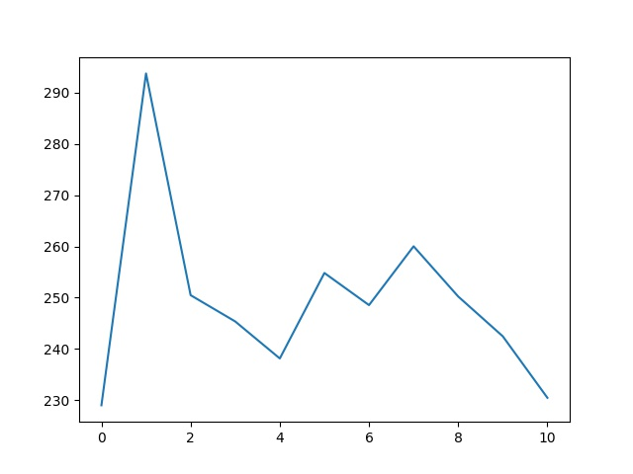
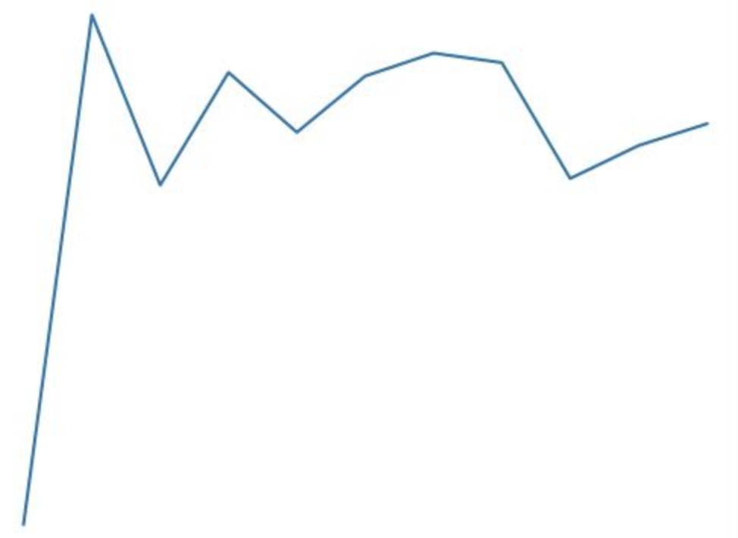
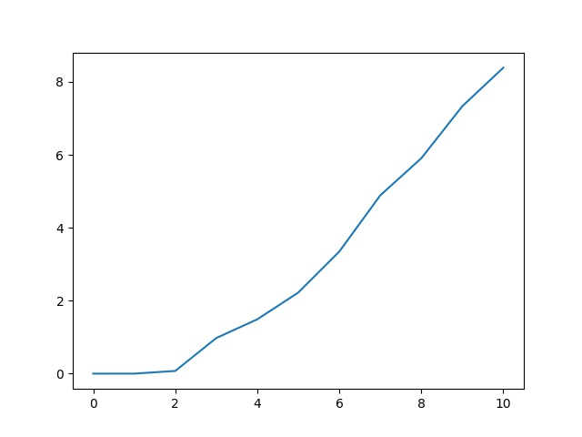
Plots
Average Q value
Loss
Average Length of game
Episodes
Episodes
Episodes

Slide 19
Let's talk about Training
We trained the network using pytorch-cuda framework
Trained over 30,000 episodes for a period of ~= 30 hours
Achieved average reward of 2000
The network was able to complete the level

Slide 20
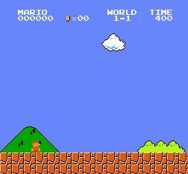
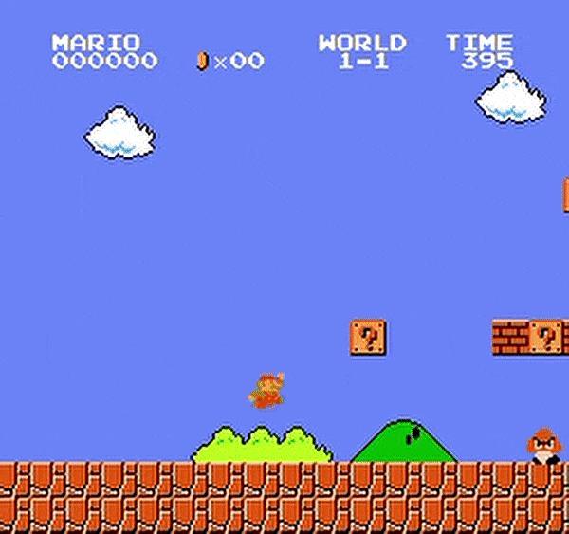
Conclusion Is it really worth it? Yes
Q Learning
Double Deep Q Learning

